Slide 1
Deep Dive into native iOS Development in Office 365 with the Microsoft Graph API
Speaker name

Slide 2
Deep Dive into native iOS Development in Office 365 with the Microsoft Graph API
</>

Slide 3
Agenda
Intro
Azure AD Auth
SharePoint Lists REST APIs
Microsoft Graph API for Exchange
Microsoft Graph API for OneDrive for Business

Slide 4
Developer vision

Slide 5

iOS SDKs
SDK generated from OData CSDL
Standard interface for all platforms
Dependency Injection optimized for each platform:
HTTP clients, Async frameworks, JSON parsers
Authentication with Azure AD Authentication Libraries
Industry-standard dependency manager support
Cocoapods (Xcode)
Popular IDE Support
Xcode
Open source end to end

Slide 6
App Developer
Add dependencies via Cocoapods
Start coding
Add DependencyResolver
Handle authentication using ADAL
Create *Client class for services
Navigate hierarchy

Slide 7
Getting Started
iOS

Slide 8
Tools
Xcode
Create a new Objective-C iOS project
Cocoapods – http://cocoapods.org
Create a Podfile
Run pod install
Dependencies are resolved automatically
Project is automatically updated

Slide 9
1
iOS Authentication with Azure AD

Slide 10
Overview
iOS ADAL
Authentication with O365 SharePoint is handled by Azure AD
Azure AD supports OAuth 2.0 – Access tokens and refresh tokens
The Active Directory Authentication Library (ADAL) provides UI and services for implementing Azure AD OAuth within an iOS app
Don’t expect to work with O365 APIs without understanding ADAL

Slide 11
iOS ADAL
Authentication UI
Support for two-factor
Caching (automatic token refreshing, silent auth)
Secure (tokens etc. are encrypted in the cache)
1
Features
2
3
4

Slide 12
iOS ADAL
Create AuthenticationContext
Call ADAL and acquire token (may prompt user)
Setup DependencyResolver, add credentials
Create Client(s)
1
Authentication process
2
3
4

Slide 13
Where can I find it?
iOS ADAL
Supports both iOS and OS X
Can be included as source project, or installed via the Cocoapods dependency manager
https://github.com/AzureAD/azure-activedirectory-library-for-objc

Slide 14
How do I use it?
iOS ADAL
If you are using Cocoapods to manage dependencies in your Xcode project, add the following line to your Podfile to install ADAL for iOS
target 'MyApp' do
pod 'ADALiOS'
end

Slide 15
What else do I need?
iOS ADAL
Before continuing, you must register your iOS app in Azure AD as a “native client” app, and obtain a client ID
This client ID is passed to the ADAL along with other information about your AD/O365 tenant

Slide 16
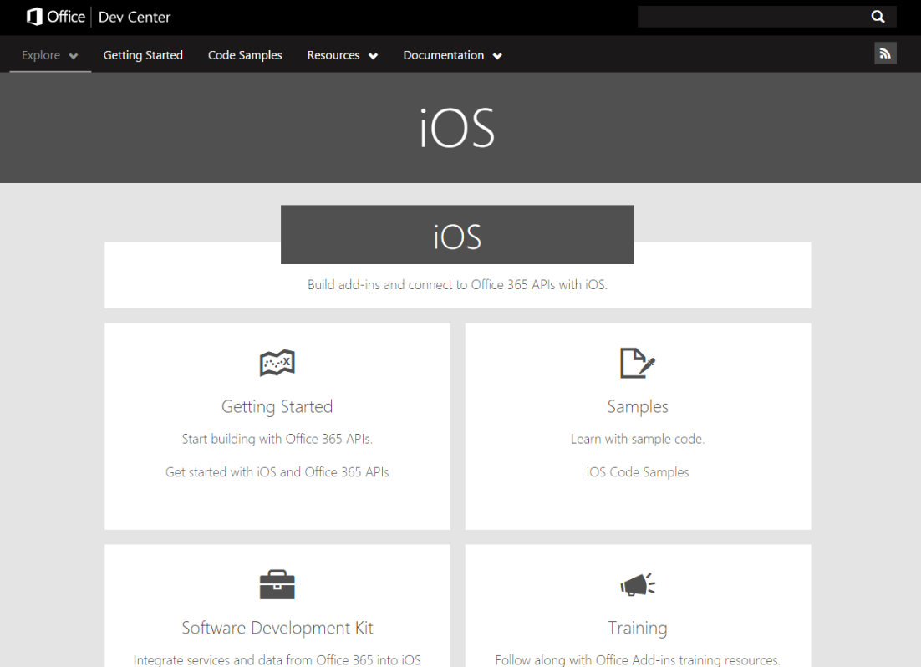
Examples
iOS ADAL
See: http://dev.office.com/ios

Slide 17
Securely storing tokens
iOS ADAL
While there are ADAL methods which accept passing refresh tokens, we don’t need to use them
ADAL automatically caches access/refresh tokens securely
Tokens stored securely using the iOS Keychain Services API

Slide 18
AD Authentication https://github.com/OfficeDev/Property-Inspection-Code-Sample
iOS ADAL

Slide 19
2
iOS Calling the O365 SharePoint lists API

Slide 20
iOS SharePoint lists
The O365 Lists REST API provides programmatic access to your Lists and List Items in O365 SharePoint Online
Authentication is handled by Azure Active Directory
Overview

Slide 21
What can I do with it?
iOS SharePoint lists
Lists
Enumerate lists
Enumerate list fields/columns
List Items
Enumerate list items
Create, read, update and delete list items

Slide 22
SharePoint lists https://github.com/OfficeDev/Property-Inspection-Code-Sample
iOS SharePoint lists

Slide 23
3
iOS Calling the Microsoft Graph API for Exchange

Slide 24
iOS Exchange
The Microsoft Graph SDK for Objective-C provides programmatic access to your Mail, Calendar & Contacts in O365 Exchange Online
Authentication is handled by the Active Directory Authentication Library for Objective-C
Overview

Slide 25
Where can I find it?
iOS Exchange
https://github.com/microsoftgraph/msgraph-sdk-ios
Install by adding to your Podfile:
target 'MyApp' do
pod 'MSGraphSDK'
end

Slide 26
What can I do with it?
iOS Exchange
Folders and Messages
Create, read, update and delete
Send new messages
Reply, reply all, forward messages
Manage attachments
Calendars and Events
Create, read, update and delete
Calendar groups
Send invites
Contacts
Create, read, update and delete

Slide 27
Exchange https://github.com/OfficeDev/Property-Inspection-Code-Sample
iOS Exchange

Slide 28
4
iOS Calling Microsoft Graph API for OneDrive for Business

Slide 29
iOS OneDrive
The Microsoft Graph SDK for Objective-C provides programmatic access to files in in your O365 OneDrive account
Authentication is handled by Azure Active Directory
Overview

Slide 30
Where can I find it?
iOS OneDrive
https://github.com/microsoftgraph/msgraph-sdk-ios
Install by adding to your Podfile:
target 'MyApp' do
pod 'MSGraphSDK'
end

Slide 31
What can I do with it?
iOS OneDrive
Files
Create, read, update and delete files and folders
Upload and download File contents

Slide 32
OneDrive for Business https://github.com/OfficeDev/Office-365-SDK-for-iOS/Samples/simple-drive-app
iOS OneDrive

Slide 33
Summary
Intro
Azure AD Auth
SharePoint Lists REST APIs
Microsoft Graph API for Exchange
Microsoft Graph API for OneDrive for Business

Slide 34
Further reading…
To get started
http://dev.office.com/ios
ADAL
https://github.com/AzureAD/azure-activedirectory-library-for-objc
Microsoft Graph SDK
https://github.com/microsoftgraph/msgraph-sdk-ios

Slide 35
Developer Program launch
1 YEAR FREE
Email Newsletters
Free Developer Subscription
Free Training
Free Tools
Webinars
http://dev.office.com/devprogram

Slide 36
Engage

